Slide 1

SAP Analytics cloud training
Anubhav Oberoy
Day 17

Slide 2

Connectivity with SAC – Types of conn.
Acquired data connection
All the data will be acquired by SAC and stored inside SAC system
All the data will be stored securely inside HANA Cloud database behind the scenes managed by SAC, you are not allowed to access this database directly
Data is updated near-real-time from Import jobs
So many options to choose like S/4HANA, BW, BPC, Big Query, Google drive, oData, One Drive
Data security is SAP’s responsibility on top we create roles to control data display
Reuse existing assets like Bex Query, CDS Views, BI Universes, data model.
Live data connection
Data is never replicated in SAC, Only the structure/skeleton of the data is stored in SAC
Light weight design because SAC do not manage any data hence the model is just a skeleton
When stories/applications are executed, the data will be subjected to return from LIVE systems
This data is always real time
If not designed properly can cause performance issues in SAC
Reuse existing assets like Bex Query, CDS Views, BI Universes, data model.
Data security, constraints are the responsibly of the underlaying system
We can use this type of connection to write back data to source, Close-loop scenario
www.anubhavtrainings.com

Slide 3
Connectivity Requirements
www.anubhavtrainings.com

Slide 4
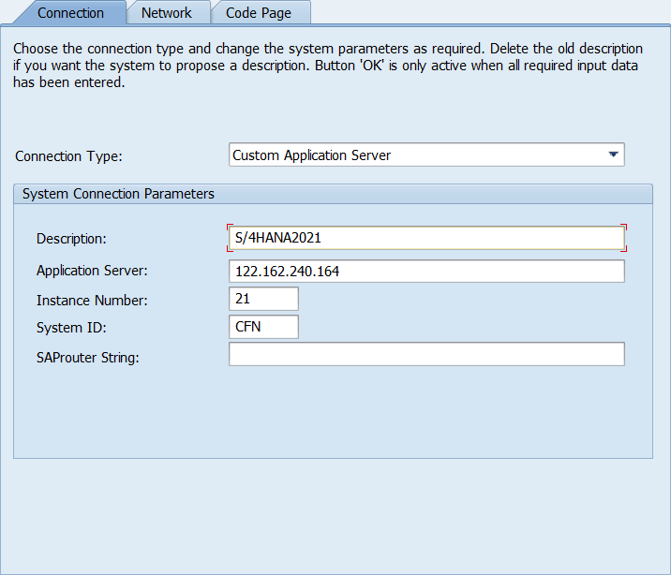
Server Access for S/4HANA / BW
www.anubhavtrainings.com

Slide 5
CORS – Cross Origin Resource Sharing
It is browser’s security policy, According to this, a browser will stop all the calls going to a external URL while running/pointing to the address bar url.
SAC server
(BTP)
SAP Analytics cloud
(Browser)
https://guided-experience-sac-ap11.cfapps.ap11.hana.ondemand.com
http://s4dev.st.com:8021/sap/bw/ina/getresponse
SAP BW
(Services/InA)
Whitelist the address of SAC system in our SAP system so that we can inform the browser that its fine to make CORS call.
Server needs to issue a CORS header to only and only allow our SAC system
Enable CORS enablement for SAP server
www.anubhavtrainings.com

Slide 6
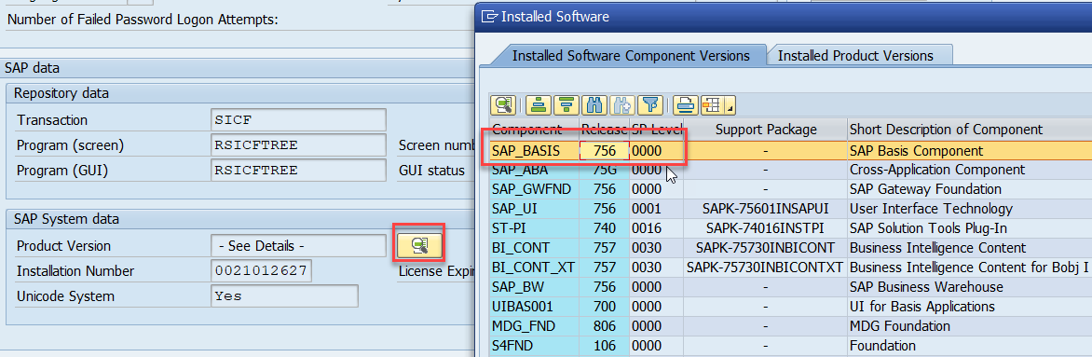
Configuration BW, S/4HANA, ECC, BPC
Check the supported net weaver version
NW 7.52 SP02
NW 7.51 SP06
NW 7.50 SP12
NW 7.40 SP20
SAP Kernel version 7.49 PL315
2. Check if the ina service is active in your system with tcode SICF /sap/bw/ina
3. The ssh must be enabled in the system and the certificate of your SAC system must be added to STRUST transaction in SAP. (exception – if you are unable to do this step in Anubhav training server, it is fine)
4. Inform our SAP system that we should allow CORS headers – RZ11 – icf/cors_enabled
5. If you are using a SAP on-premise system protected via firewall, you need cloud connector. Anubhav Training system do not require it because our SAP BW is publicly accessible.
6. Maintain the CORS header settings to issue CORS token to the browser where SAC is running to tell browser, hey browser! I am okay to trust this SAC tenant. TCode – UCONCOCKPIT
https://blogs.sap.com/2019/03/24/use-cors-for-your-netweaver-backend-connection-to-cloud-analytics/
www.anubhavtrainings.com

Slide 7
Title
Add the following comma separated list to Allowed Headers: X-CSRF-TOKEN,X-SAP-CID,AUTHORIZATION,MYSAPSSO2,X-REQUEST-WITH,SAP-REWRITEURL,SAP-URL-SESSION-ID,CONTENT-TYPE,ACCEPT-LANGUAGE
Add the following comma separated list to Exposed Headers: X-CSRF-TOKEN,SAP-REWRITEURL,SAP-URL-SESSION-ID,SAP-PERF-FESREC,SAP-SYSTEM
Allow Credentials: Ensure this is selected
Click on green checkmark to continue the setup
Save the configuration
Restart your App servers with the changed parameters
www.anubhavtrainings.com

Slide 8
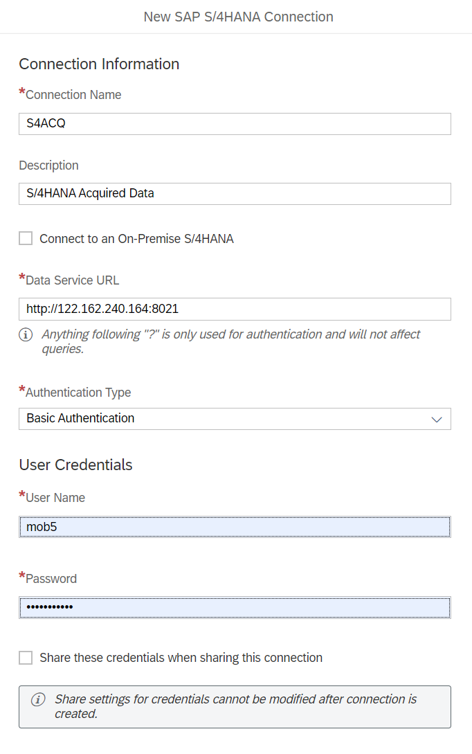
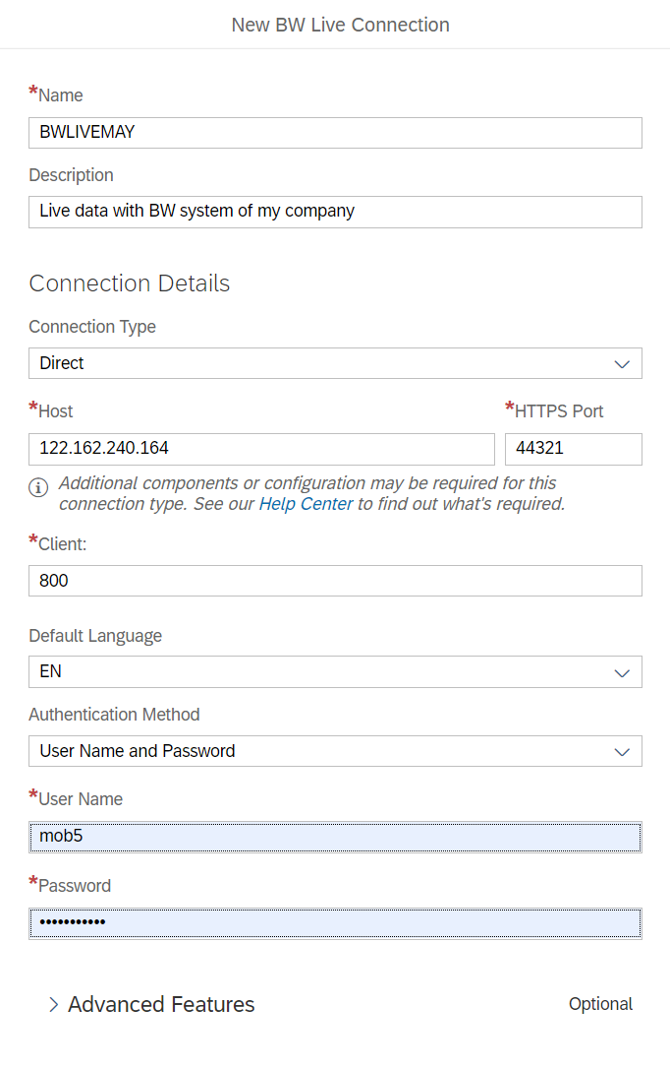
Maintain connection in SAC
www.anubhavtrainings.com

Slide 9
Hint : To Avoid SSL Error
Press F12 key and then observe network call when click Ok button.
There was an error with red color, we double click on red call and allow browser to connect
Again, click on SAC session
www.anubhavtrainings.com

Slide 10
What is CDS Views?
ABAP System (Application Layer)
CDS View
Private – Never consume them directly, contract can change
Interface views – reusable and makes transaction and master data available
Consumption – Final consumption
HANA Database
HANA View
www.anubhavtrainings.com

Slide 11
Sales Analytic Dashboard
Create a CDS view in SAP System with sales data (standard sap CDS view), it should allow us to analyze total sales in common currency (currency conversion)
Per country
Per product
Per customer
BillingStatus
Disclaimer
If you are not comfortable with CDS views, you can join ABAP on HANA. OR ask the S/4HANA developers in your company to create views for your consumption in SAC.
Ctrl + 6 – open a GUI Session
/n/IWFND/MAINT_SERVICE – tcode to register the service in SAP
www.anubhavtrainings.com

Slide 12
End of Day 17

Slide 13

Questions

Slide 14

Anubhav Oberoy
anubhav.abap@gmail.com

